Slide 1
CapStone Project
CV2

Slide 2
Abstract of problem statement
EDA on car images data set
Utilize given annotations with class labels to map them with cars images
Develop CNN model for classification of cars
Develop a model to create bounding box on given car image

Slide 3
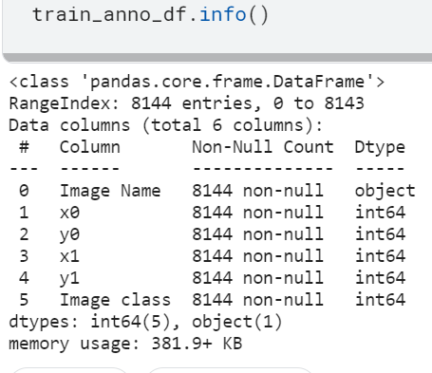
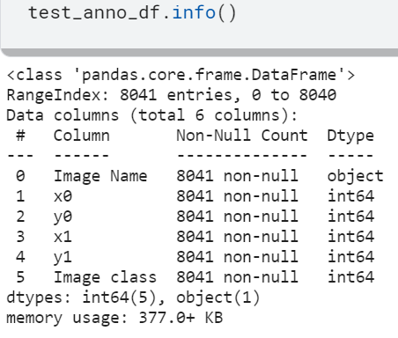
EDA on car images data set
Training annotations | Testing annotations
Unique number of car labels ➔ 196
Total images in train data ➔ 8144, Total images in test data ➔ 8041
NaN check ➔ No NaNs are present in annotations data

Slide 4
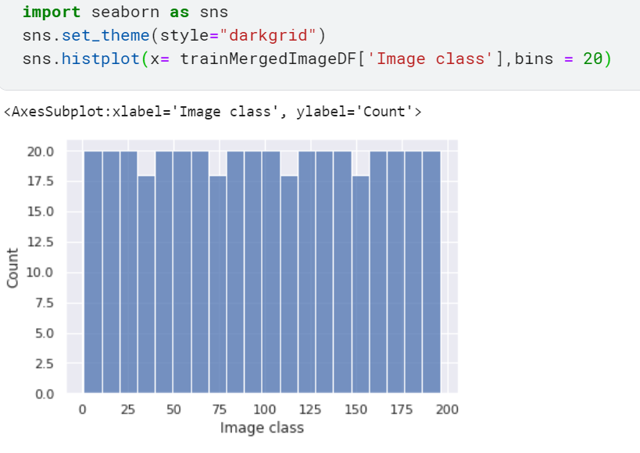
Distribution of classes in train data
Data is equally distributed in car classes

Slide 5
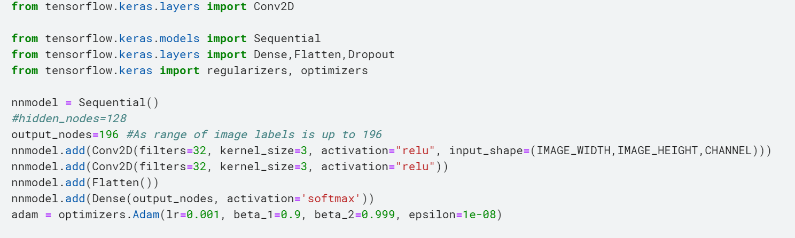
Basic CNN model for classification
2 hidden layers
(IMAGE_WIDTH,IMAGE_HEIGHT,Channels)=(128,128,3)
filters 32
Kernal size 3
Optimizer = Adam
Final loss and accuracy [6.785179615020752, 0.011224489659070969]

Slide 6
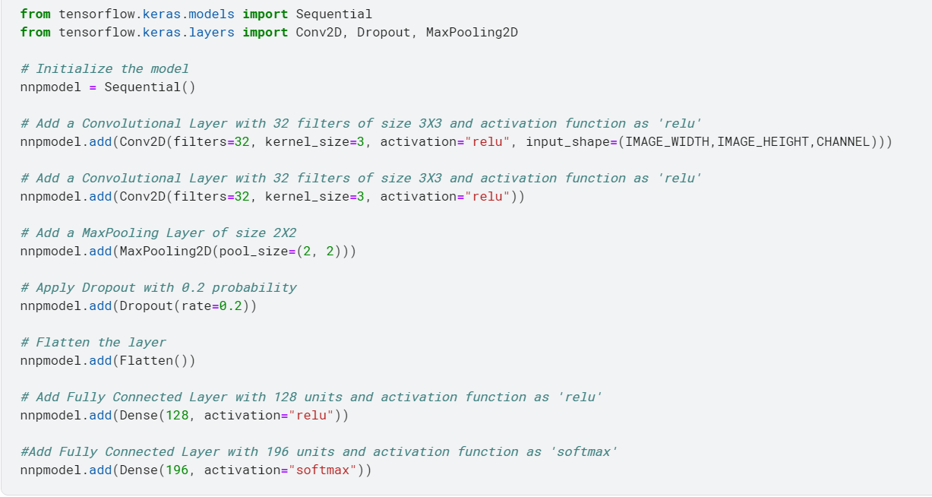
CNN model with MaxPool 2D for classification
5 hidden layers
Additions in basic architecture
Max pool 2D
Dropout
Final loss and accuracy [14.108733177185059, 0.004081632476300001]

Slide 7
Further tuning
Image data augmentation
Use batch normalization
Add padding in CNN architecture
Use callbacks for modelcheckpoints,earlystopping ,learning rate scheduling.
Use cross validation
Use keras optimizer

Slide 8
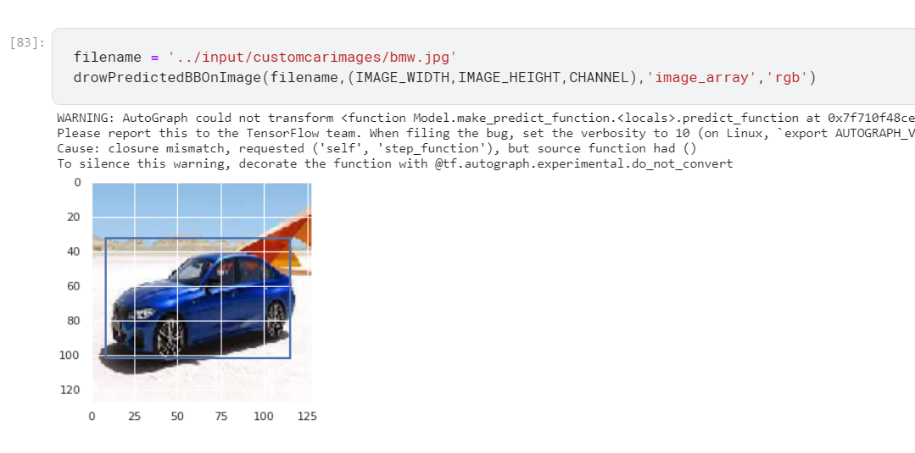
Bonding box creation through Mobilenet
Model loss and accuracy i.e IoU [57.377281188964844, 0.8023837208747864]

